Slide 1

北京大学线上研究生面试
双机位说明（国内版 P2-5）
Double Standby Instructions (International Version P6-9)

Slide 2
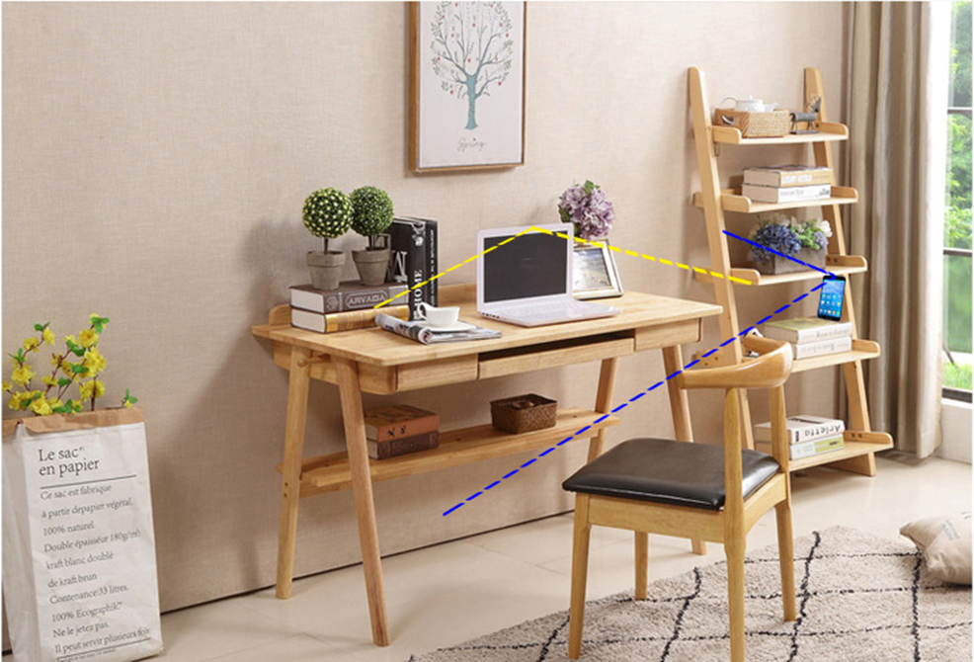
1.场景示意图（中国大陆用户）
面试研究生电脑登录个人主账号进行面试，将手机架在一旁，登录微信小程序，对周围的面试环境进行拍摄。
同一个手机号可在PC客户端和微信小程序同时登录并加入会议

Slide 3
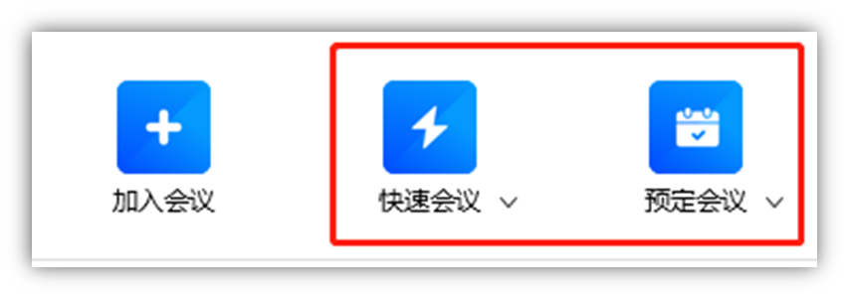
2. 面试研究生客户端入会说明
面试研究生客户端下载地址：
https://meeting.tencent.com/download-center.html
老师登录账号，发起会议，并将会议号分享给面试研究生

Slide 4
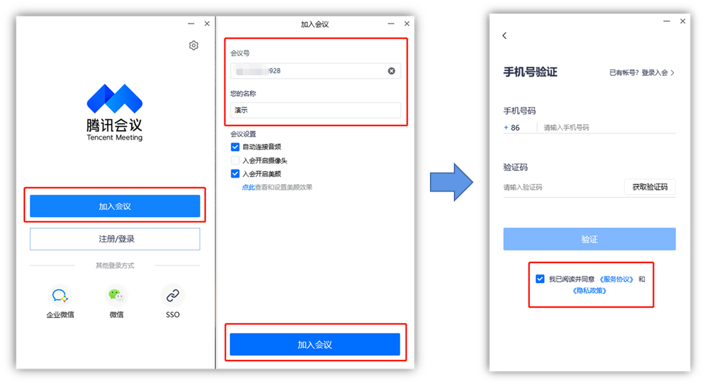
3. 面试研究生使用电脑加入会议
打开腾讯会议客户端，点击加入会议
输入会议号和面试研究生姓名，点击加入会议
弹出手机号验证界面，输入个人手机号，获取验证码，勾选下方“我已阅读并同意《服务协议》和《隐私政策》” ，点击验证，即可进入会议

Slide 5

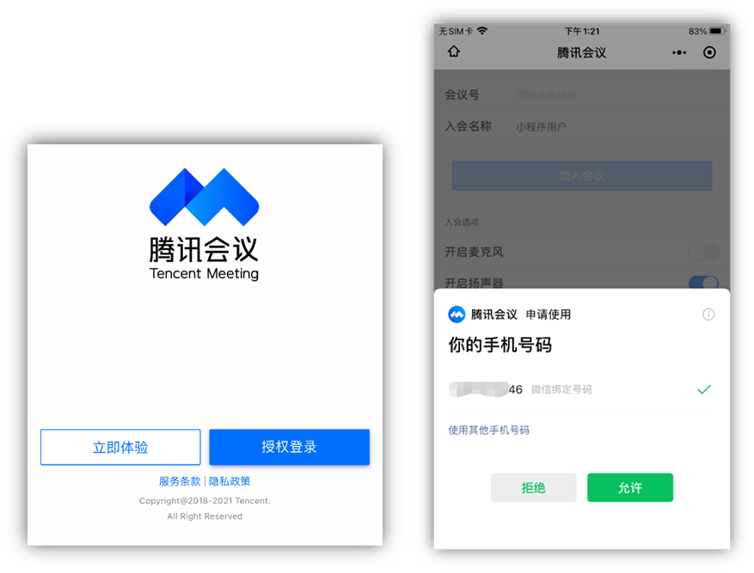

4. 面试研究生微信小程序加入面试（拍摄面试环境）
面试研究生需要开启第二摄像头，可通过手机微信小程序加入会议。微信搜索“腾讯会议”或扫描下方二维码，进入微信小程序
使用腾讯会议微信小程序时，需要进行“授权登录”和手机号码验证。允许后，输入会议号和入会名称即可成功进入会议

Slide 6
1. Scene diagram（Users outside mainland China）
The interview was conducted by logging in to the personal main account, putting the mobile phone aside, logging in to the WeChat applet, and photographing the surrounding interview environment.
With the same mobile phone number, you can log in and join the meeting at the same time in the PC client and WeChat applet
The meeting number of VOOV and Tencent conference is interchangeable, you can directly call the meeting number to join the conference

Slide 7

2. Interview graduate student client entry instructions
Postgraduate Interview Client Download Address:
https://voovmeeting.com/download-center.html
The teacher logs in the account, initiates the meeting, and shares the meeting number with the interviewing graduate students

Slide 8
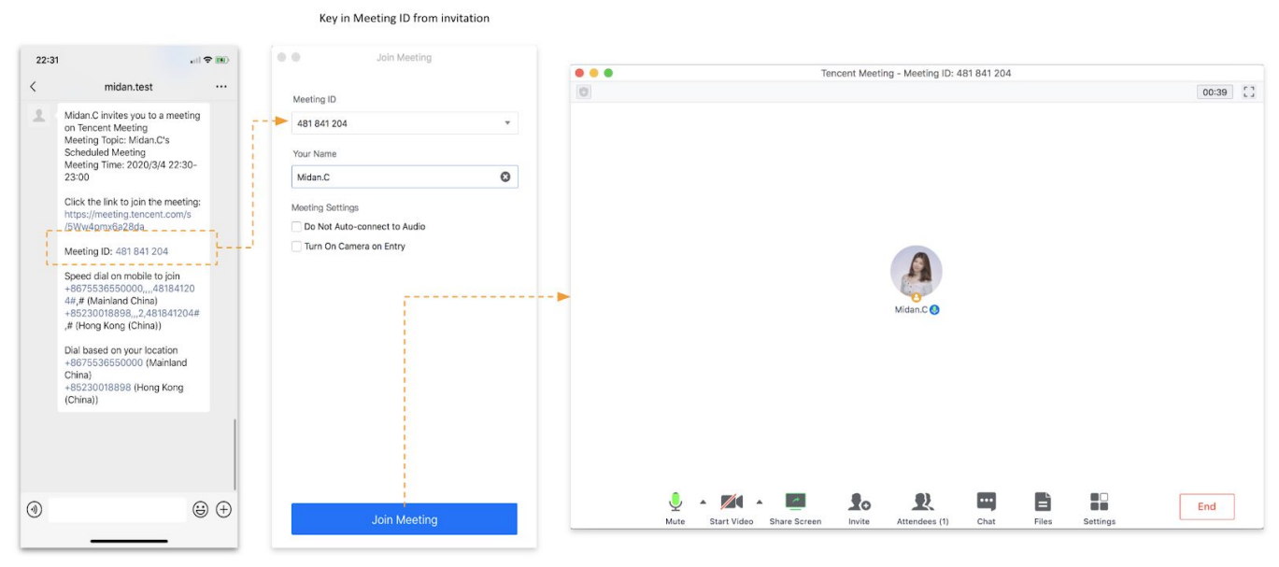
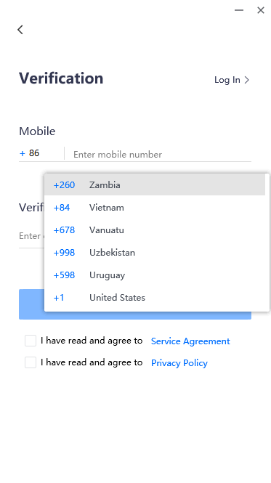
3. Interview graduate students using computers to join meetings
Open the VOOV client and click to join the meeting
Enter the meeting number and the name of the interviewing graduate student, and click to join the meeting
The mobile phone number verification interface pops up, input the personal mobile phone number (please pay attention to select the international area code, not the mainland phone number), get the verification code, check the box below "I have read and agree to the Service Agreement and Privacy Policy", and click the verification to enter the conference

Slide 9
4. Join the interview with WeChat applet (shoot the interview environment)
raduate students need to turn on the second camera to interview, you can join the meeting through the mobile phone WeChat applet.Search "Tencent Conference" on WeChat or scan the QR code below to enteWeChatB1 Mini Program
When using Tencent conferencing WeChat applet, you need to conduct "authorized login" and mobile phone number verification.After permission, enter the meeting number and membership name to enter the meeting successfully

